Slide 1
Anticoagulation
Prepared by Cherie Gan

Slide 2
QUIZ
https://tinyurl.com/y6u2ooyo

Slide 3
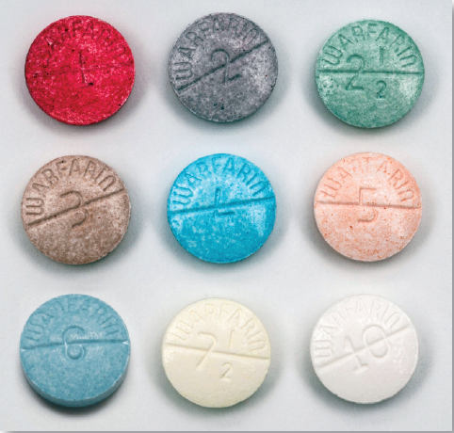
Let’s talk about warfarin first

Slide 4
warfarin
Mechanism
Inhibits Vit K epoxide reductase needed to reduce Vit K into the reduced form. Reduced Vit K is needed for the enzyme that synthesises Factors II VII IX X and Protein C and S.

Slide 5
Mechanism of action of warfarin
Reduced vitamin K
Oxidised vitamin K
Gamma carboxylation
Inactive precursor
FII, VII, IX, X
Functional
FII, VII, IX, X
Glutamic acid
carboxy-glutamic acid
Notes:
Warfarin is made in liver and released as inactive precursors. To make them functional need to gamma carboxylate
Need vitamin k

Slide 6
Mechanism of action of warfarin
Warfarin
Vitamin K reductase
Reduced vitamin K
Oxidised vitamin K
Gamma carboxylation
Inactive precursor
FII, VII, IX, X
Functional
FII, VII, IX, X
Glutamic acid
carboxy-glutamic acid

Slide 7
Warfarin initiation
Bridging w Heparin
When initiating warfarin, need to overlap with heparin for about five days and until INR is therapeutic (≥2) for at least 24h, before stopping heparin
Reason is because Warfarin inhibits Protein C and S also, which have short half-lives, and these are anticoagulant factors. If you do not do heparin bridging, then there is a risk of paradoxical thromboembolism when initiating warfarin
Protein C and S have a short half life while FX has a half-life of 5 days
Therefore 5 days overlap with heparin is required for FX levels to decrease sufficiently and have a true antithrombotic effect
Hence to start LMWH and warfarin together and to overlap for at least 5 days or when INR >2 for at least 24 hours (whichever is the longer)- to be safe we try to fulfill BOTH of these

Slide 8
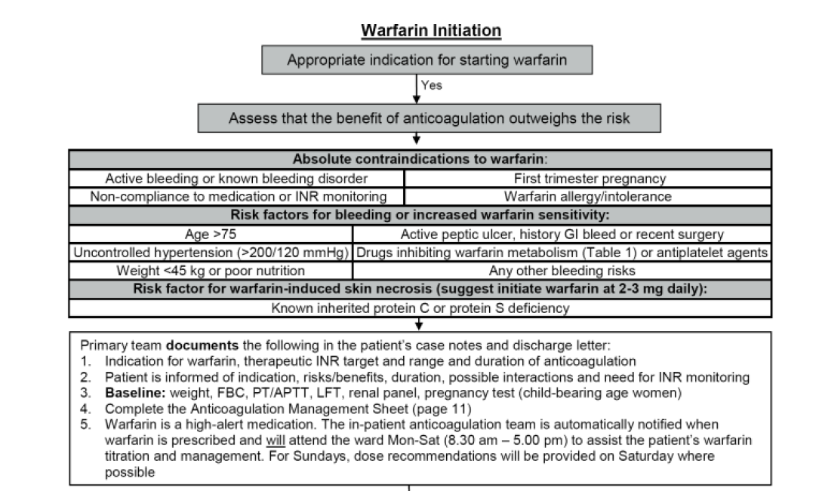

Slide 9
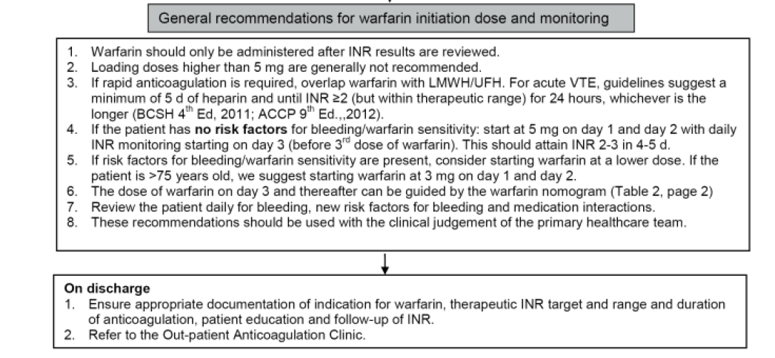

Slide 10
Interactions with drugs and food
To avoid labile INR, need to keep the dietary intake of Vit K relatively constant (same amount of green leafy vegetables every day)
Avoid foods that can affect the liver enzymes eg TCM

Slide 11
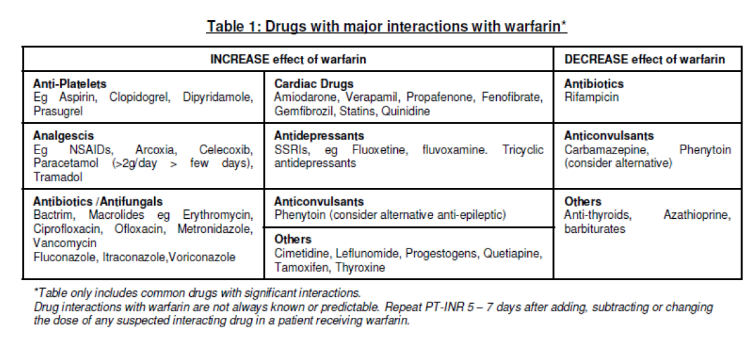
Drugs that interact with warfarin

Slide 12
What to do w over-warfarinisation
Ensure no major bleed in brain
Identify sites of bleed
Possible ways to reverse the over-warfarinisation
  Can overcome warfarin effect by giving vitamin K, because there are actually 2 vitamin k reducing enzymes. One less sensitive (vit K reductase) and vit k can bypass
  Can bypass warfarin effect by giving functional clotting factor (FFP/Prothrombin Complex Concentrate)
    But rmb that still need to give IV VIt K because the half-lives of the factors are very short

Slide 13
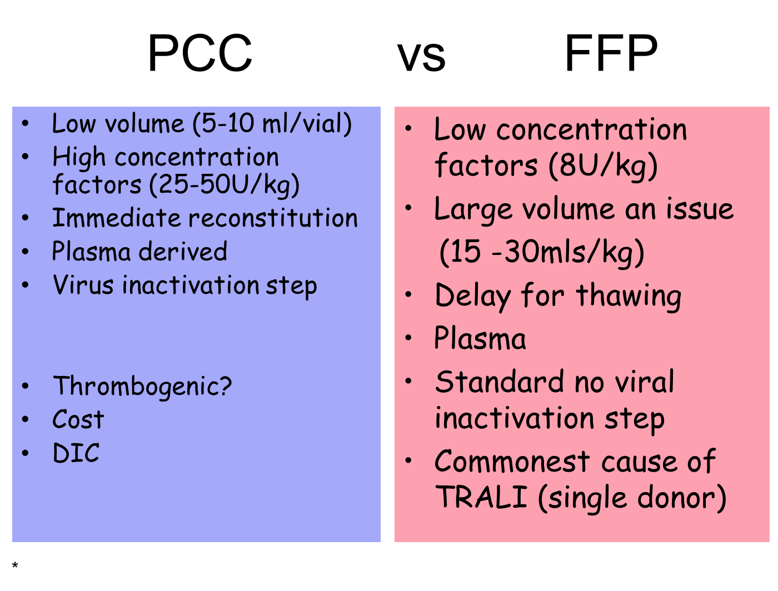

Slide 14
Warfarin reversal
  In major bleeding or emergency reversal for surgery
    IV vitamin K 5-10 mg and
    Factor replacement with Prothrombin Complex Concentrate (PCC) or FFP
  If minor bleeding – stop warfarin and give low dose vitamin K (2 mg PO or 1 mg IV)

Slide 15
NO BLEED:
  INR > 5 but not bleeding: 1-2 doses of warfarin withheld and maintenance dose reduced, investigate cause of elevated INR
  INR ≥ 8.0, asymptomatic :Oral vitamin K 1-5 mg, recheck INR next day
Surgery that requires reversal of warfarin, can be delayed 6- 12 hr: IV vitamin K
Surgery requiring reversal of warfarin, cannot be delayed: PCC and IV vitamin K

Slide 16
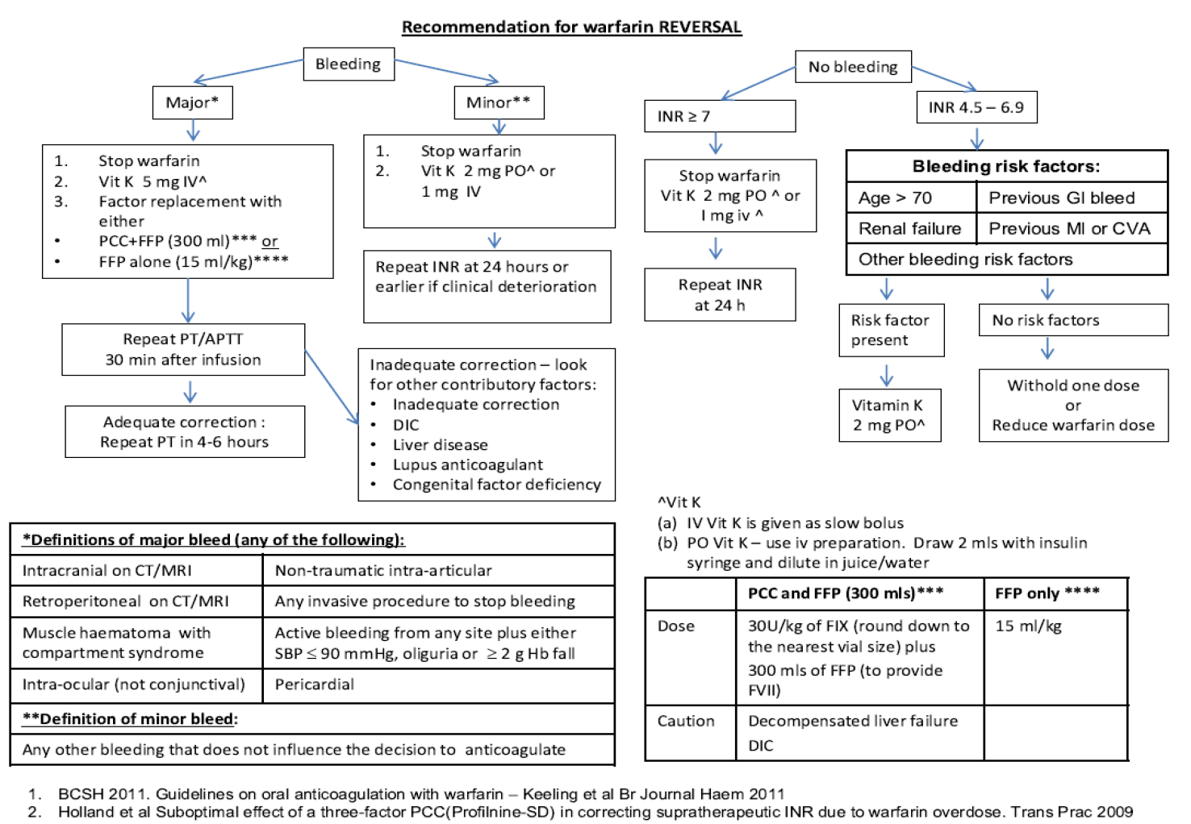

Slide 17
Peri- op management of warfarin. Stopping warfarin before elective surgery
The most appropriate perioperative strategy is to stop warfarin 5 days before the procedure and forego bridging anticoagulation. This patient is scheduled for an invasive procedure with a high risk of bleeding and therefore requires discontinuation of warfarin for surgery. Stopping warfarin 5 days before surgery usually achieves the standard target of an INR of less than 1.5. HOWEVER, MUST DECIDE IF PT IS AT HIGH RISK OF THROMBOEMBOLISM- IF SO, WILL NEED BRIDGING W HEPARIN OR CLEXANE (no role for NOACs for bridging)
In perioperative patients who require interruption of chronic anticoagulation, the need for bridging anticoagulation must be determined, typically with the use of the CHADS₂score + indication for anticoagulation in the first place eg Bridging typically done if high risk patient eg prosthetic valve/ high chadsvas score

Slide 18
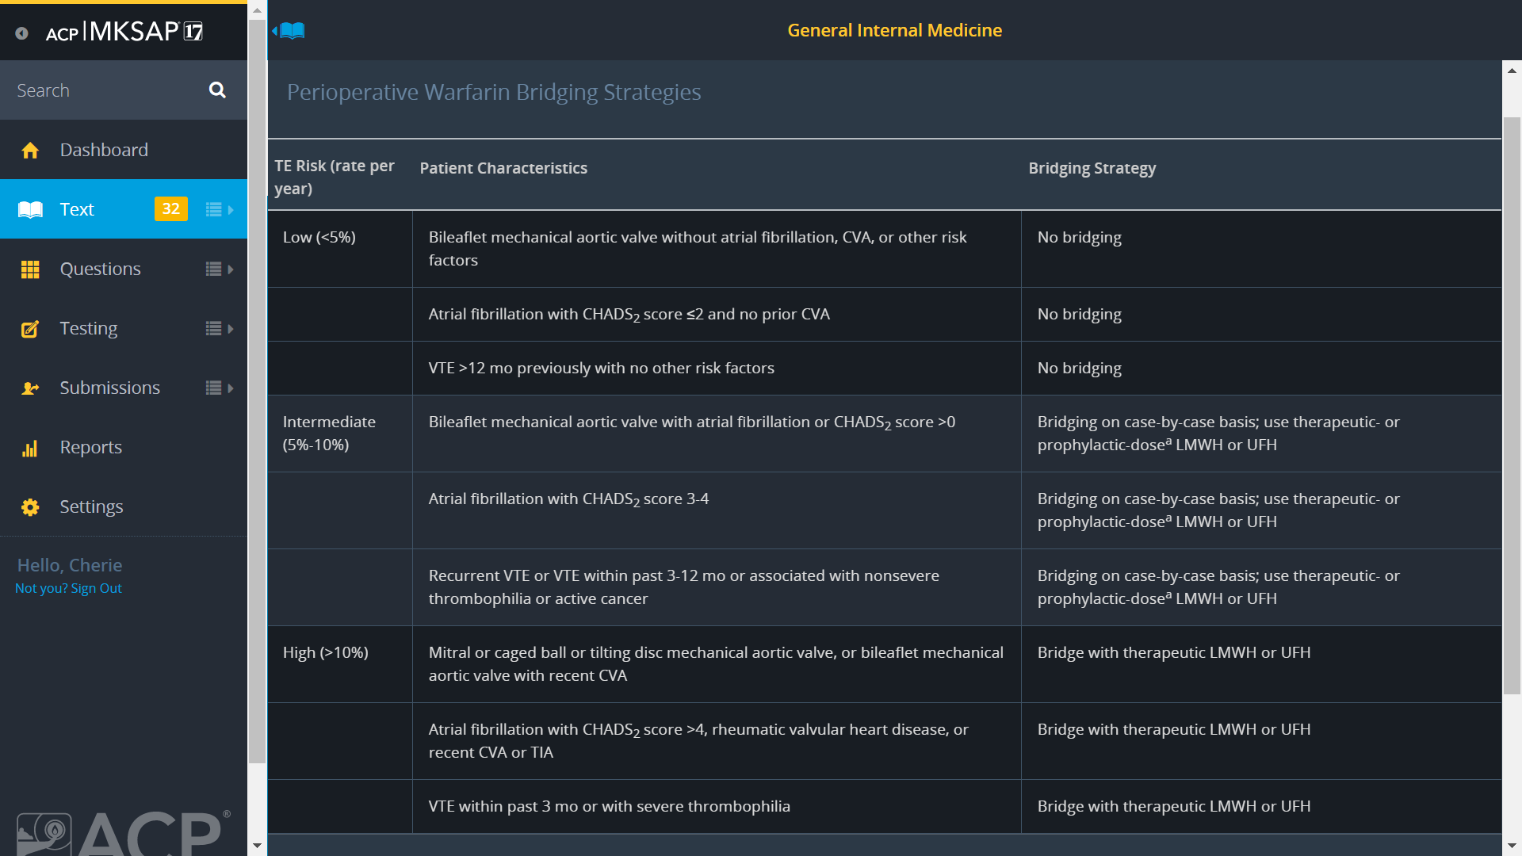
Notes:
Adapted from Douketis JD, Spyropoulos AC, Spencer FA, et al. Perioperative management of antithrombotic therapy: Antithrombotic Therapy and Prevention of Thrombosis, 9th ed: American College of Chest Physicians Evidence-Based Clinical Practice Guidelines. Chest. 2012;141(2 suppl):e326S-e350S. PMID: 22315266

Slide 19
When bridging w clexane vs heparin
Before operation, heparin can be stopped 6-12h before op
Clexane must be stopped 24h before op (longer half life)

Slide 20
Post op restarting of warfarin
Heparin / clexane should be given for at least 5 days and only discontinued at that time if the INR is therapeutic ie INR >2 for 24 hours.
Warfarin may be initiated on the first or second day of heparin therapy.
Because factor II and X levels require at least 5 days to decline sufficiently, parenteral anticoagulation should overlap with warfarin for at least 5 days and until an INR of 2 or more is achieved.

Slide 21
Heparin and LMW Heparin

Slide 22
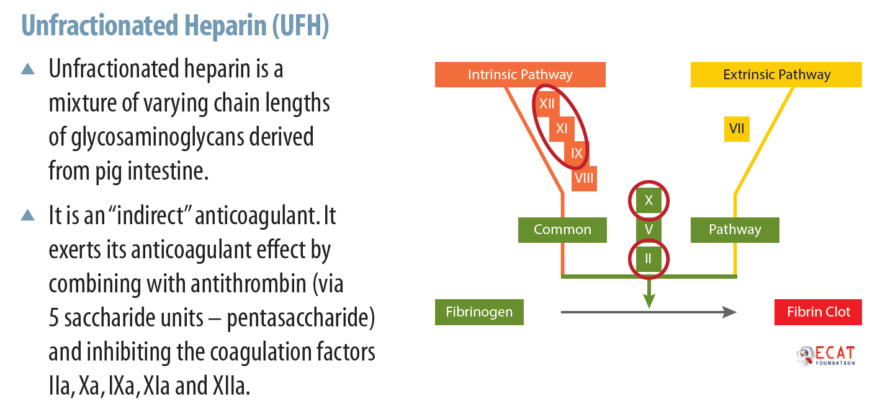

Slide 23
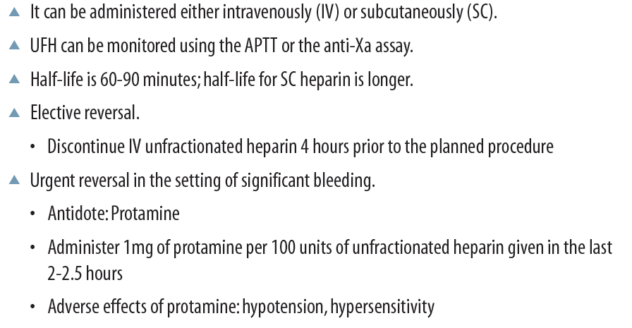
Unfractionated heparin

Slide 24
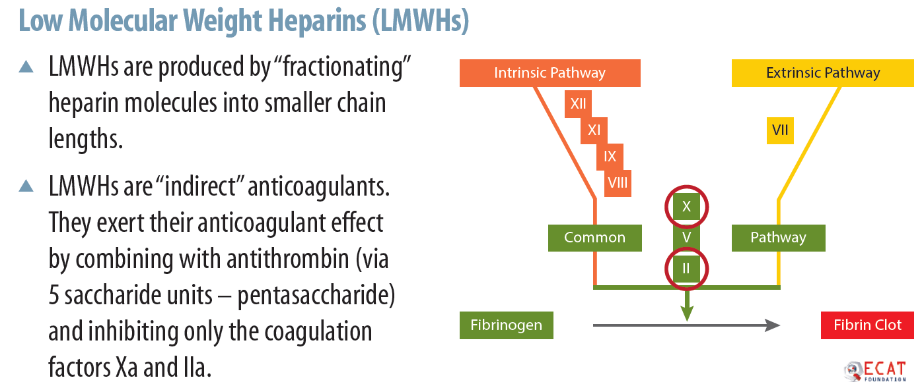
LMW heparin eg clexane ie enoxaparin

Slide 25
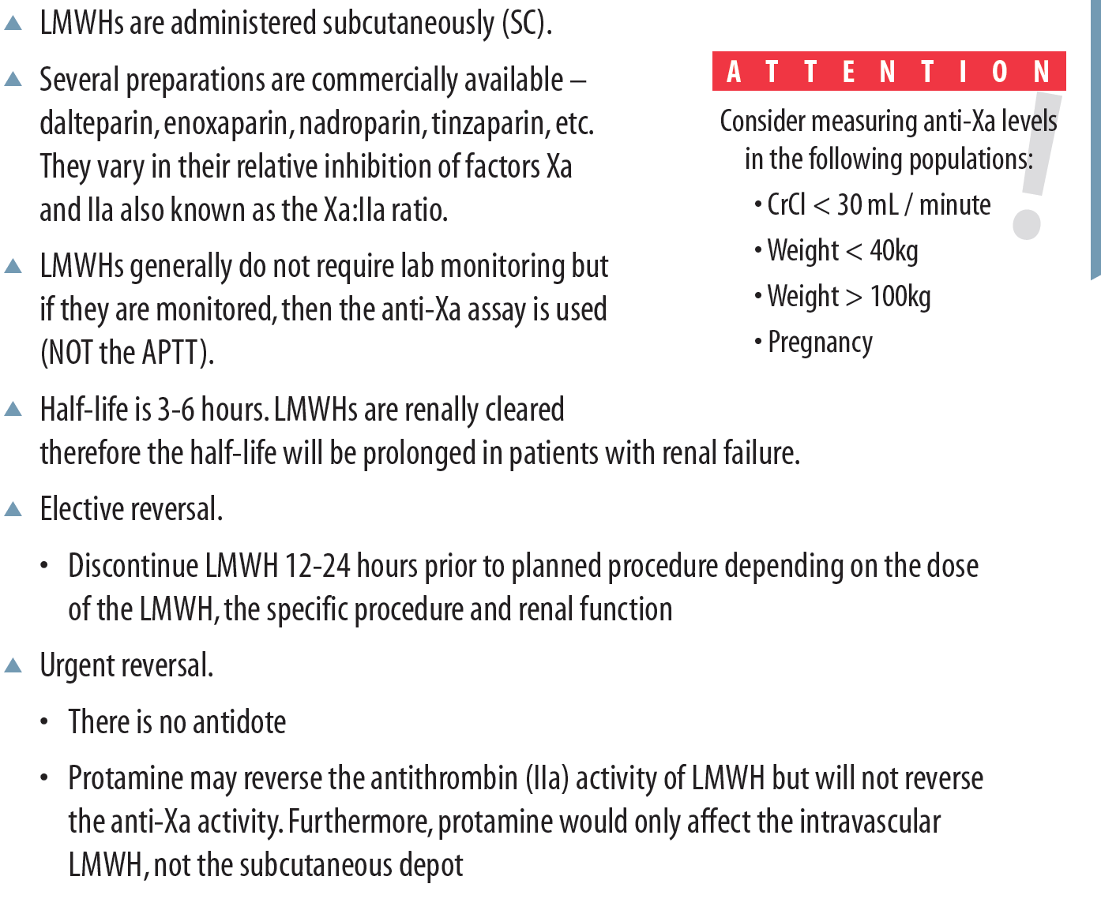

Slide 26
NOACs

Slide 27
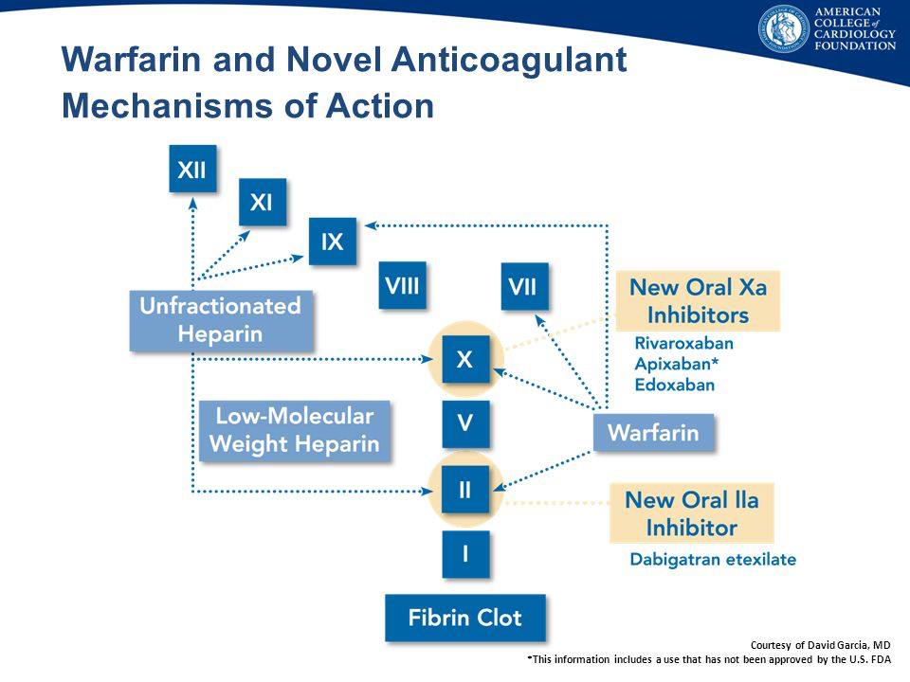

Slide 28
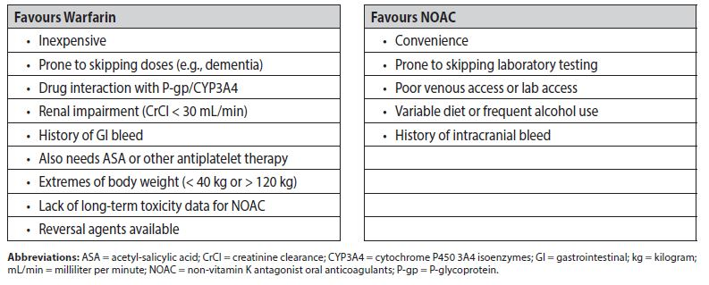
Valvular AF can only use warfarin. NOACs not proven for valvular AF
Advanced renal impairment, mechanical valve replacement, valvular AF → can only use warfarin and not NOACs!

Slide 29
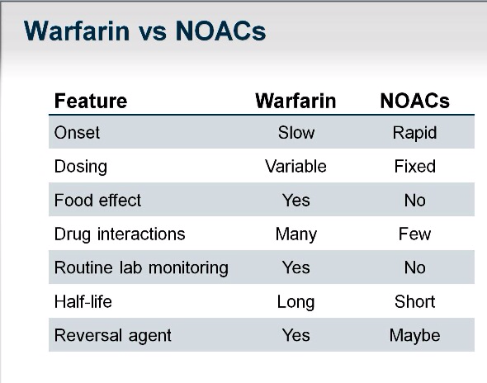
Only NOAC w antidote is dabigatran. Antidote is idaricizumab

Slide 30
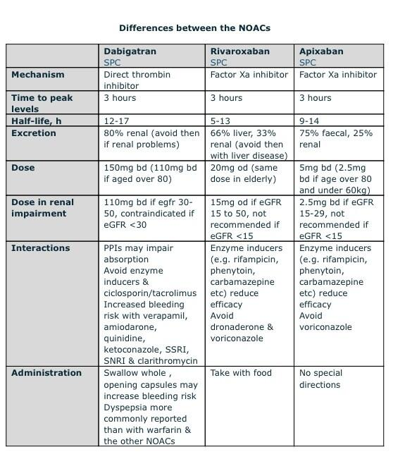
Rivoroxaban is once daily dosing in AF vs dabigatran and apixaban are BD
All cannot be used in renal failure

Slide 31
Credits
NUH warfarin protocol
NUH Dr Koh LP lecture

